Slide 1


Opportunity for Public Comment
PFC Application 8
Rapid City Regional Airport
February 17, 2026

Slide 2
Overview
The City of Rapid City (the City) intends to submit a new PFC application to the Federal Aviation Administration (FAA) for 19 projects at Rapid City Regional Airport (the Airport)
The proposed application was described in the public notice from June of 2025; the current notice reflects the updated PFC request for the application
The PFC Level for the Airport will continue to be $4.50 per eligible enplaned passenger
Estimated charge effective date for the application: June 1, 2033
Estimated charge expiration date for the application: August 1, 2035
Estimated total PFC revenue to be collected under application: $4,664,208
Project No. | Project Title | PFC Pay-as-you-go
1 | Rehabilitate Runways 5-23 and 14-32 | $ 181,674
2 | Wildlife Hazard Assessment | $ 3,571
3 | Apron Expansion Phase 1 and 2 (Design and Construction) | $ 112,405
4 | Runway 5-23 Lighting Upgrade | $ 598
5 | Update Airport Master Plan and Airport Layout Plan Including AGIS | $ 27,972
6 | SRE Acquisition | $ 64,739
7 | Runway 14-32 and Runway 5-23 PAPI Replacement (Design and Construction) | $ 15,812
8 | Commercial Service and GA Apron Rehabilitation (Design and Construction) | $ 134,575
9 | Terminal Study | $ 10,821
10 | General Aviation Apron Reconstruction and Commercial Apron Rehabilitation (Design and Construction) | $ 76,402
11 | Bag Claim Number 1 Replacement (Design and Construction) | $ 24,558
12 | Vertical Circulation Improvements (Design and Construction) | $ 175,674
13 | Environmental Assessment for Sanitary Sewer Improvements | $ 8,391
14 | Rehabilitate Access Road (Design) | $ 6,667
15 | Replace Passenger Boarding Bridges (Design) | $ 25,556
16 | Rehabilitate Taxiway (Design) | $ 3,056
17 | Construct Access Road (Design) | $ 4,722
18 | PFC Consulting Services | $ 15,000
19 | Terminal Expansion (Design) | $ 3,772,015
 | TOTAL | $ 4,664,208

Slide 3
Opportunity for Public Comment
In accordance with Section 158.24 of 14 CFR Part 158, these materials constitute the notice of opportunity for public comment on the application and include:
  PFC level, estimated total PFC revenue to be collected, proposed charge effective date, and estimated charge expiration date
  Name and contact for the person within the public agency to whom the comments should be sent
  A description and brief justification of the projects
Public comments may be submitted until March 19, 2026 and should be sent to:
  Toni Broom, Deputy Airport Director
  toni.broom@rcgov.org

Slide 4
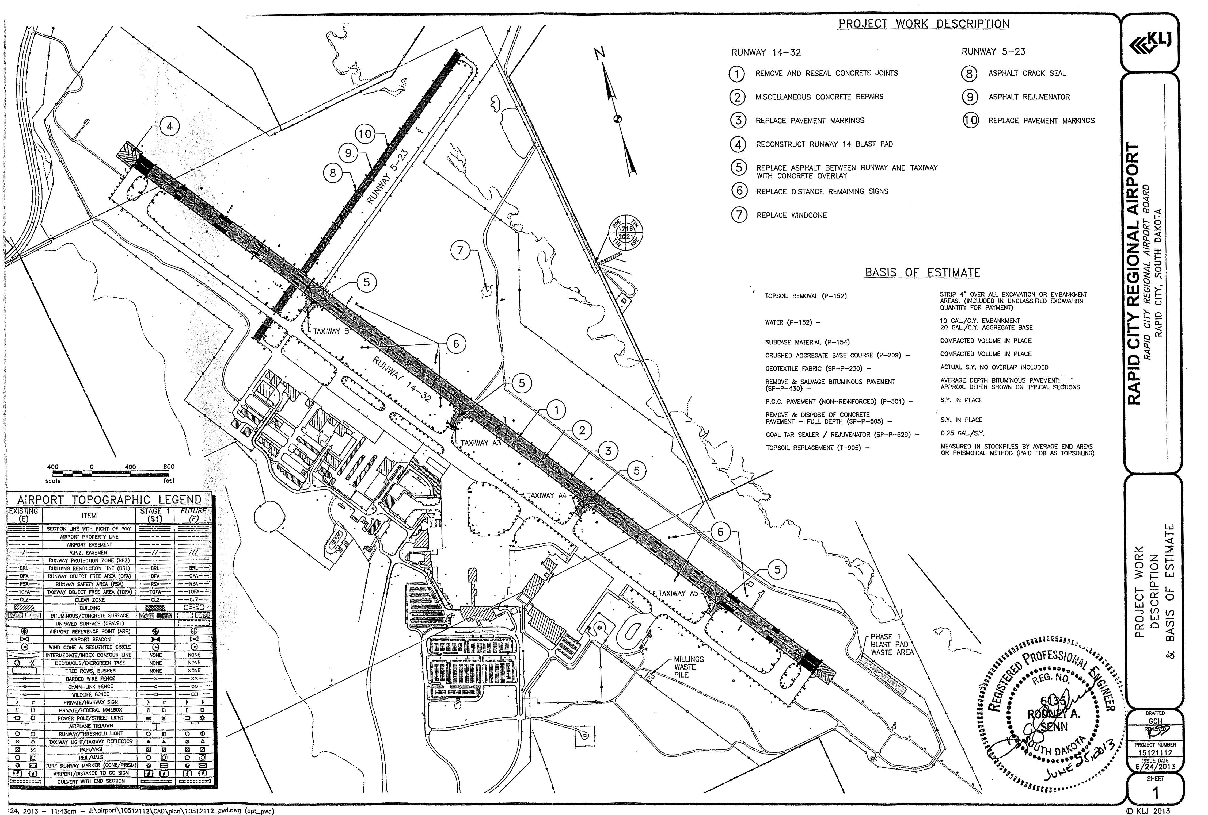
Proposed Projects
Rehabilitate Runways 5-23 and 14-32
DESCRIPTION
Rehabilitation of Runways 14-32 and 5-23 pavements, involving joint sealing, crack repair, spall repair, full depth concrete panel replacement, asphalt rejuvenator, marking obliteration and repainting, installation of a new wind cone with a tilt down pole, and the installation of new distance remaining signs for Runway 14-32.
In addition, this project included the reconstruction of the Runway 14 blast pad as well as the construction of PCC overlay pavement for Taxiways B, A3, A4, and A5.
JUSTIFICATION
Preserve the capacity of the Airport.

Slide 5
Proposed Projects
Wildlife Hazard Assessment
Apron Expansion Phase 1 and 2 (Design and Construction)
DESCRIPTION
Development of a Wildlife Hazard Assessment per the requirements of 14 CFR Part 139.337. The scope of work included (1) wildlife hazard assessment and training, (2) wildlife hazard management plan, and (3) FAA airport wildlife training.
The work included an analysis of events that prompted the assessment, identification of the wildlife species observed, identification of features that attract wildlife, a description of wildlife hazards, and recommended actions for reducing wildlife hazards to air carrier operations.
JUSTIFICATION
Enhance safety at the Airport.
DESCRIPTION
Design and construction services for (1) the demolition of the Airport's prior terminal, known as apron expansion Phase 1 and (2) apron reconstruction (Phase 2) at the Airport.
Phase 1: demolition of the old commercial airport terminal building and the associated parking lots and pavement.
Phase 2: construction of the midfield apron pavement. Work included earthwork, aggregate base course, underdrain system, P-501 PCC pavement, fence installation, and miscellaneous items.
JUSTIFICATION
Expand capacity at the Airport.

Slide 6
Proposed Projects
Runway 5-23 Lighting Upgrade
Update Airport Master Plan and Airport Layout Plan Including AGIS
DESCRIPTION
In order to address instrument approach requirements, Runway 5-23 lighting was upgraded in this project.
Construction activities involved trenching in of conduit, placing electrical wire, installing four new threshold lights, and replacing all of the prior Runway 5-23 runway light lenses with split lenses for the instrument approach lighting system requirements.
JUSTIFICATION
Enhance safety at the Airport.
DESCRIPTION
Preparation of an Airport Master Plan and Airport Layout Plan (ALP), including Airport Geographic Information Systems (AGIS) component.
The Master Plan involved the development of an air traffic forecast and the evaluation of future facility needs at the Airport.
An ALP was developed and submitted to the FAA as part of this work effort.
JUSTIFICATION
Expand capacity at the Airport.

Slide 7
Proposed Projects
SRE Acquisition
Runway 14-32 and Runway 5-23 PAPI Replacement (Design and Construction)
DESCRIPTION
Design, specifications, bidding, negotiations, and final acceptance for five new pieces of snow removal equipment (SRE).
The SRE consisted of two multi-use snow hauler trucks with attachments, one high speed runway plow vehicle, one wheel loader, and one sand truck. In addition, this project includes the development of specifications (excluding cost of purchase) for one broom.
JUSTIFICATION
Preserve capacity at the Airport.
DESCRIPTION
Design and construction of the Runway 14-32 four box PAPI units and Runway 5-23 two box PAPI units and associated wire and components.
This project installed new PAPI control units and removed the prior PAPI control units that were mounted in the Runway Safety Areas.
JUSTIFICATION
Preserve capacity at the Airport.

Slide 8
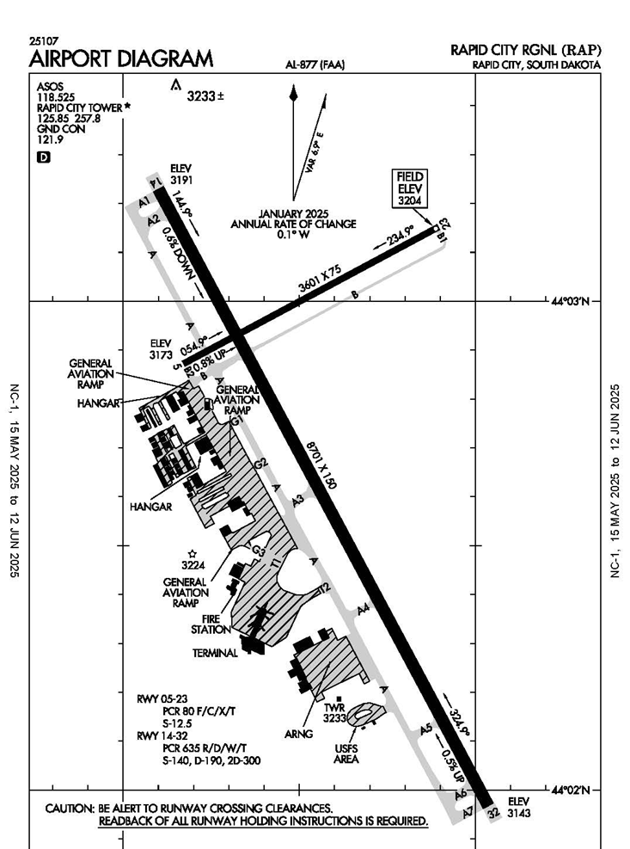
Proposed Projects
Commercial Service and GA Apron Rehabilitation (Design and Construction)
DESCRIPTION
The general aviation apron reconstruction included demolition of the existing apron, including excavation of the old apron area, extension of the sewer system, placement of subbase and 11 inches of PCC concrete pavement on the north side, and placement of subbase and 15 inches of PCC concrete pavement on the south end of the apron.
The rehabilitation of the commercial apron included joint sealant removals and resealing of the commercial apron, old terminal apron, and Taxiways T-1 and T-2, as well as the repainting of all existing apron paint markings.
The expansion of the commercial apron consisted of the expansion of the west side of the commercial apron directly to the west of the terminal building.
JUSTIFICATION
Preserve capacity at the Airport.

Slide 9
Proposed Projects
Terminal Study
GA Apron Reconstruction & Commercial Apron Rehab (Design and Construct)
DESCRIPTION
A preliminary study and recommendations on improvements to the terminal baggage make-up area, escalator replacement, security system analysis and sanitary sewer analysis.
JUSTIFICATION
Preserve capacity at the Airport.
DESCRIPTION
Reconstruction of a portion of the general aviation apron which included asphalt pavement removals, earthwork subgrade, aggregate base course material, an underdrain system and placement of 8" and 11" PCC concrete.
The section of reconstruction of the GA apron is the area directly in front of the FBO main hangar building.
Also included in the scope of work is the rehabilitation of a section of the commercial apron located under two of the Airport's passenger boarding bridges, which included full depth concrete panel removals/replacements and PCC pavement partial depth spall repairs.
JUSTIFICATION
Preserve capacity at the Airport.

Slide 10
Proposed Projects
Bag Claim Number 1 Replacement (Design and Construction)
Vertical Circulation Improvements (Design and Construction)
DESCRIPTION
Design and construction services associated with the replacement of one of the Airport's baggage handling system inbound claim devices.
The prior unit was originally installed in the old terminal building prior to 1987 and had exceeded its useful life.
The scope of work included removal of the existing baggage conveyor and associated components, and installation of the new baggage conveyor, security roll-up doors, and associated equipment, including electrical controls and wiring.
JUSTIFICATION
Preserve capacity at the Airport.
DESCRIPTION
Design and construction services related to the reconstruction of the Airport terminal building escalator, elevator, and stairway.
In addition, this project included construction services related to the replacement of the Airport's chiller.
JUSTIFICATION
Preserve capacity at the Airport.

Slide 11
Proposed Projects
Environmental Assessment for Sanitary Sewer Improvements
Rehabilitate Access Road (Design)
DESCRIPTION
This project included design services for an access road rehabilitation on the Airport's east terminal access road.
JUSTIFICATION
Preserve capacity at the Airport.
DESCRIPTION
This project involved the development of an environmental assessment for a new sanitary sewer system at the Airport.
JUSTIFICATION
Preserve capacity at the Airport

Slide 12
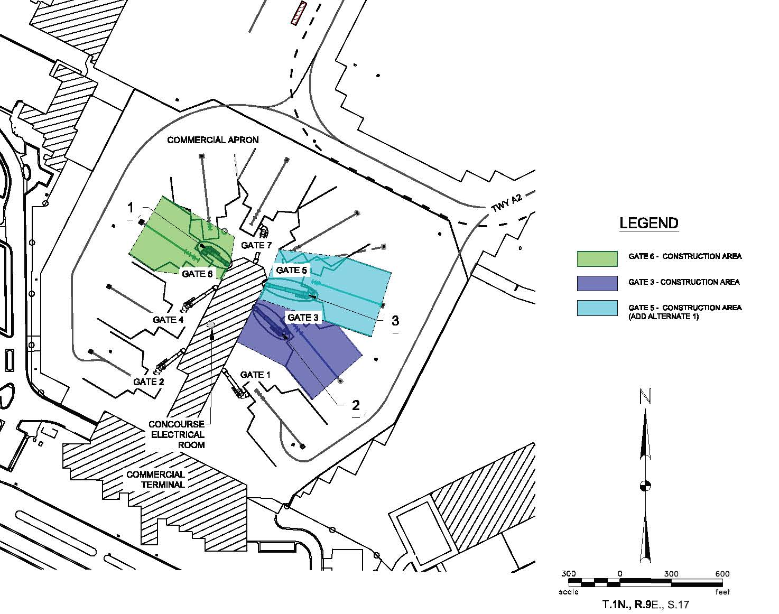
Proposed Projects
Replace Passenger Boarding Bridges (Design)
DESCRIPTION
Design of three replacement passenger boarding bridges at the Airport's Gates 3, 5, and 6, including upgrades to electrical power supply and new foundations as necessary.
The three passenger boarding bridges replaced existing passenger boarding bridges as these gates.
JUSTIFICATION
Preserve capacity at the Airport.

Slide 13
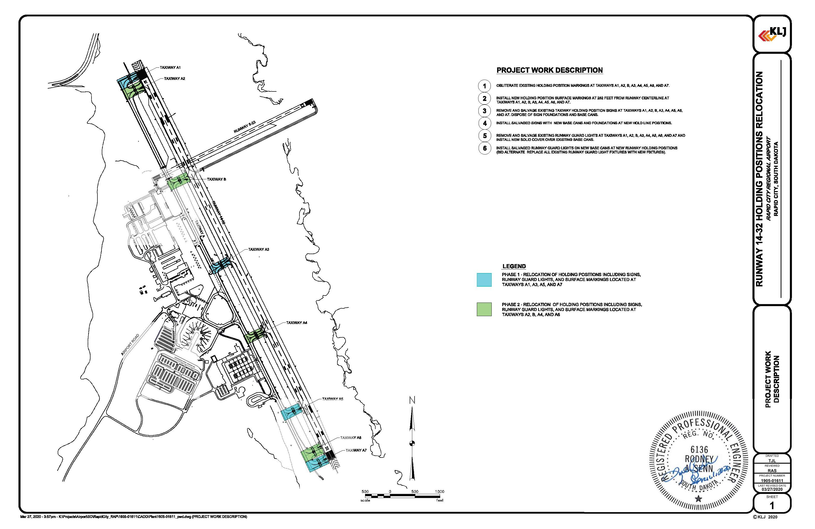
Proposed Projects
Rehabilitate Taxiway (Design)
DESCRIPTION
Design services associated with the relocation of Runway 14-32 hold lines and signage to meet setback standards.
The tasks included in the design are the relocation of holding positions including signs, runway guard lights, and surface markings located at Taxiways A1, A3, A5, A7, A2, B, A4, and A6.
JUSTIFICATION
Preserve capacity at the Airport.

Slide 14
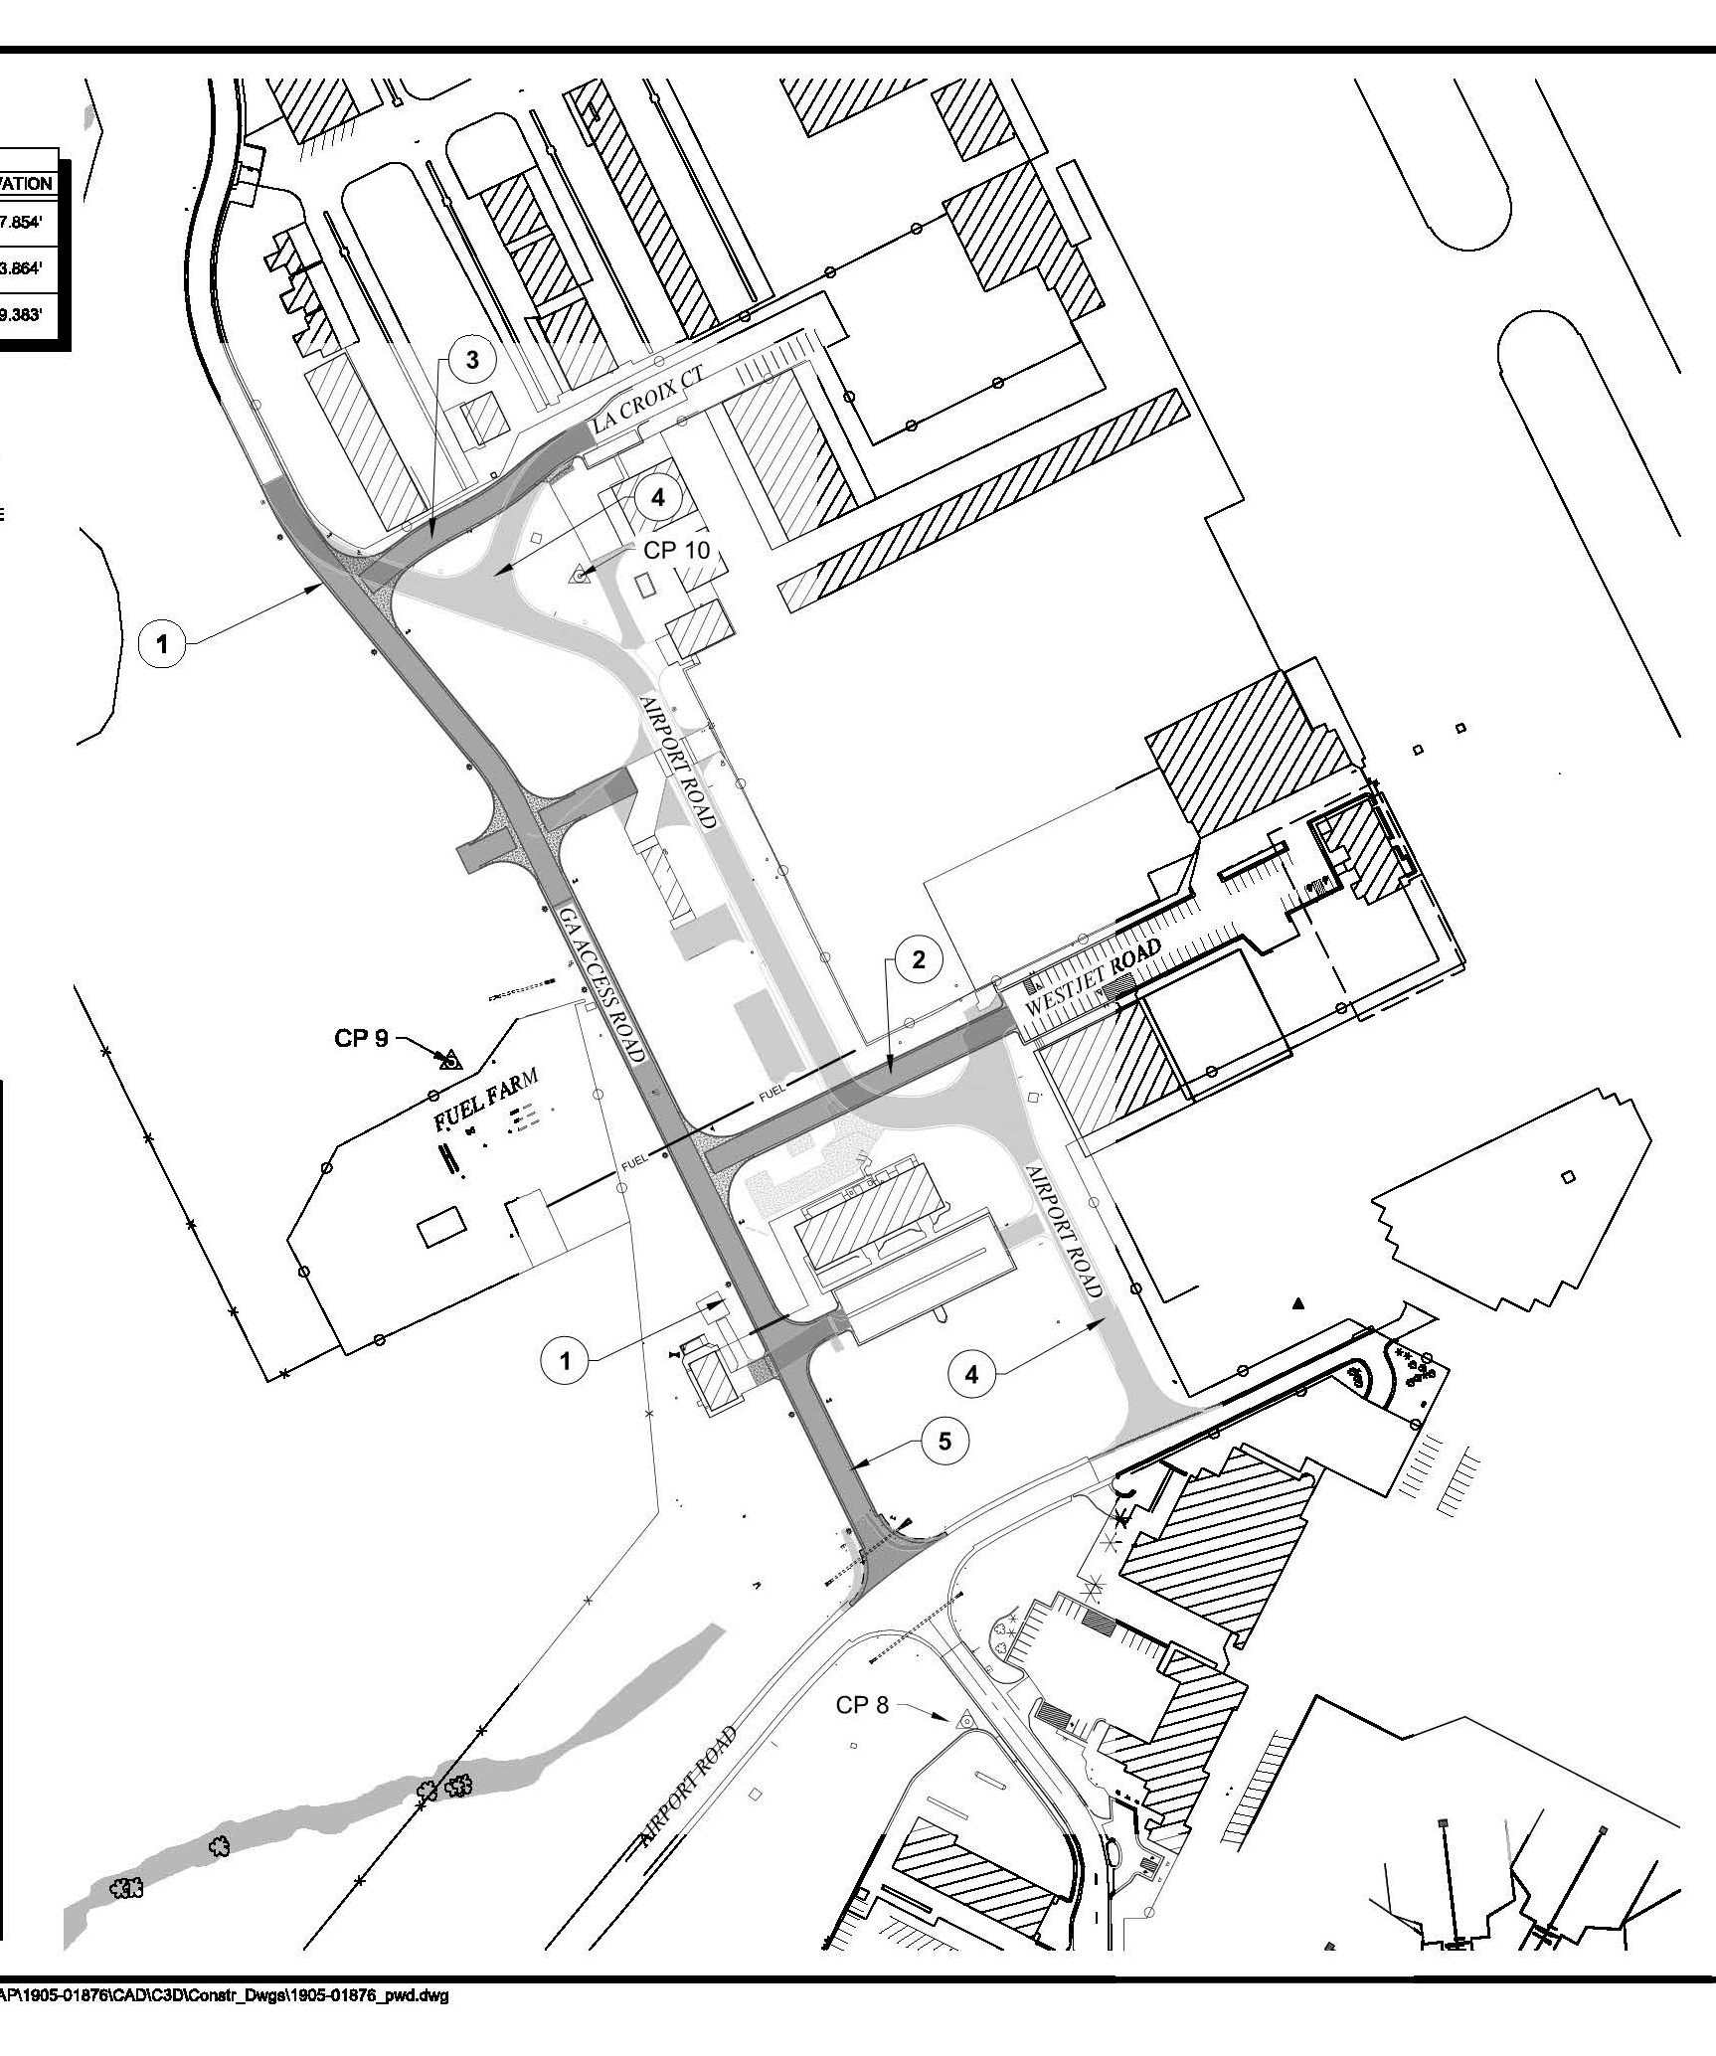
Proposed Projects
Construct Access Road (Design)
DESCRIPTION
Design of a general aviation access road (including realignment).
The new GA access road connects to the prior Airport Road at La Croix Court and provides a new access road to the west of the existing access road.
JUSTIFICATION
Expand capacity at the Airport.

Slide 15
Proposed Projects
PFC Consulting Services
Terminal Expansion (Design)
DESCRIPTION
This project includes design services associated with the Airport's Terminal Renovation and Expansion (Phases 1 and 2).
Phase 1 will expand the airport's ticketing, checked baggage area, and TSA checkpoint.
Phase 2 will expand the Airport's gate area, adding approximately five new gates.
JUSTIFICATION
The expansion and renovation of the Airport is necessary to accommodate existing and project passenger growth and to accommodate shifts in aircraft type. The existing terminal was built in 1986, and the last major renovation and improvement project was completed in 2012.
DESCRIPTION
The project includes consulting services related to the preparation of this PFC Application.
This project would cover PFC consulting fees for the period November 2024 through September 2025.
JUSTIFICATION
PFC application preparation is eligible for reimbursement as a PFC administrative support cost under CFR 158.13(b).

