Slide 1
The Economic Impact of the Rapid City Regional Airport
Christian Glupker
Clinical Professor of Economics

Slide 2
Scope of Work
The economic impact of RAP on Pennington County.
A comparison to the 2020 South Dakota Economic Impact Study for RAP
A comparison to the impact of other airports on their respective communities.
A measure of significance to specific industries.

Slide 3
Summary of Methodology
Impact categories
Commercial visitors
General aviation visitors
Airport operations
Airport capital investment
Airport business tenants

Slide 4
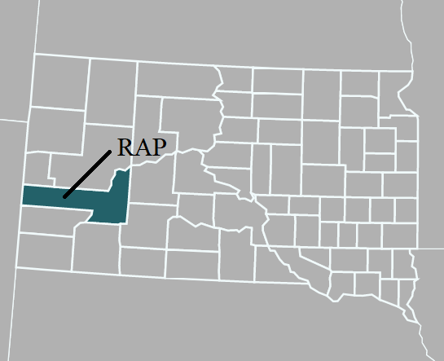
Summary of Methodology
Defining the economic region
Economic Model
Direct impact (direct spending)
Indirect impact
Induced impact
Output, labor income, value-added, and jobs

Slide 5
Commercial Visitors
October 2022 to October 2023: Wi-Fi intercept survey
8,836 Survey Requests
7,537 Usable surveys

Slide 6
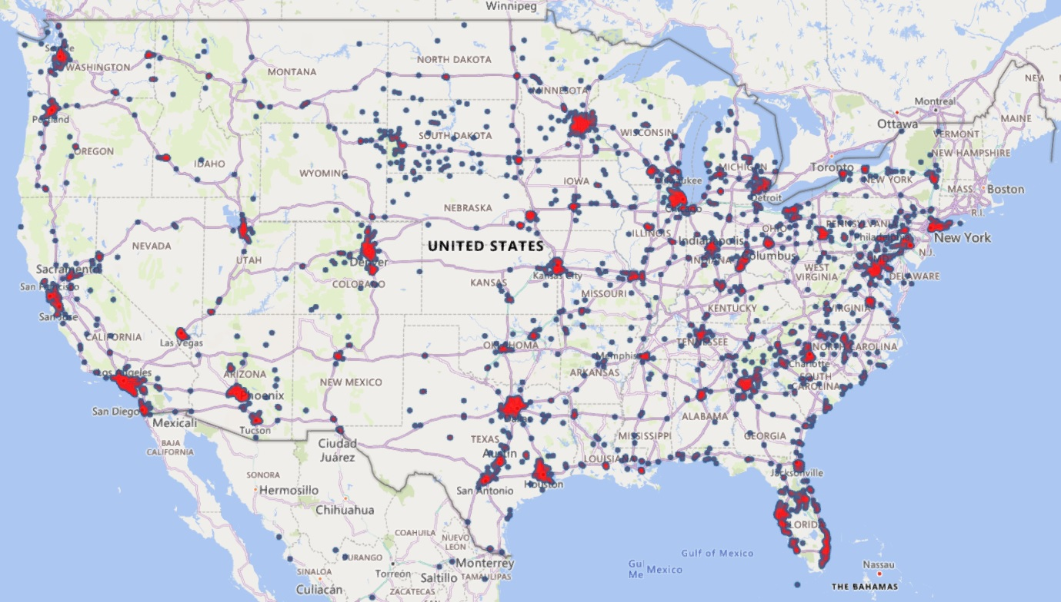
Visitor Surveys – Sampling Results

Slide 7
Defining a Visitor
Local Visitor
Nonlocal Visitor

Slide 8
Nonlocal Commercial Visitors
 | Pennington County
2022 Total enplaned passengers | 338,458
% of nonlocal passengers | 63.2%
Total number of nonlocal passengers | 213,978
The average number of nights | 3.63
Total number of nonlocal visitor days | 776,740

Slide 9
Nonlocal Commercial Visitors- Spending
Spending PPPD | Spending PPPD
Meals | $56.11
Lodging | $81.99
Transportation | $35.99
Retail Spending | $13.12
Gear Rental | $1.91
Other Spending | $7.88
Total | $197.00
 | Spending details
Average spending per person, per day | $197.00
Total direct spending from nonlocal visitors | $153M

Slide 10
Nonlocal Commercial Visitors-
Economic Impact
Pennington County | Jobs | Labor Income | Value-Added (GDP) | Output
Direct Impact | 1,050 | $33M | $72M | $118M
Indirect Impact | 211 | $12M | $20M | $41M
Induced Impact | 178 | $10M | $17M | $30M
Total Impact | 1,439 | $55M | $110M | $188M

Slide 11
Nonlocal Commercial Visitors-
Fiscal Impact
 | Sub-County: Municipalities | Sub-County: Special Districts | Pennington County | South Dakota
Direct Impact | $1,199,060 | $1,380,426 | $529,420 | $3,733,515
Indirect Impact | $226,457 | $260,702 | $102,546 | $725,332
Induced Impact | $212,603 | $244,755 | $95,692 | $676,926
Total Impact | $1,638,119 | $1,885,883 | $727,657 | $5,135,772

Slide 12
General Aviation
Benefit transfer method
Local vs. Itinerant vs. Transient GA flights
37,228 GA flights in 2022
81% are assumed itinerant
33% of itinerant are transient

Slide 13
General Aviation- Visitors and Spending
 | Overnight visitors | Day visitors
GA visitors | 56,013 | 27,588
GA visitor days | 117,627 | 27,588
GA direct spending | $41.8M | $3.0M
Total GA direct spending | $44.8M

Slide 14
General Aviation- Economic Impact
Pennington County | Jobs | Labor Income | Value-Added (GDP) | Output
Direct Impact | 420 | $12M | $23M | $35M
Indirect Impact | 62 | $3.5M | $5.8M | $12M
Induced Impact | 61 | $3.5M | $6.0M | $10M
Total Impact | 543 | $19M | $34M | $58M

Slide 15
General Aviation- Fiscal Impact
 | Sub-County: Municipalities | Sub-County: Special Districts | Pennington County | South Dakota
Direct Impact | $427,615 | $492,295 | $188,921 | $1,324,229
Indirect Impact | $66,142 | $76,144 | $29,909 | $211,630
Induced Impact | $72,865 | $83,884 | $32,796 | $231,999
Total Impact | $566,622 | $652,323 | $251,626 | $1,767,858

Slide 16
Airport Operations: Economic Impact
Pennington County | Jobs | Labor Income | Value-Added (GDP) | Output
Direct Impact | 33 | $2.6M | $3.3M | $2.9M
Indirect Impact | 0 | $0 | $0 | $0
Induced Impact | 10 | $568,000 | $978,000 | $1.7M
Total Impact | 43 | $3.1M | $4.2M | $4.6M

Slide 17
Airport Operations - Fiscal Impact
 | Sub-County: Municipalities | Sub-County: Special Districts | Pennington County | South Dakota
1 - Direct | $3 | $0 | $1,040 | $9,260
2 - Indirect | $0 | $0 | $0 | $0
3 - Induced | $11,912 | $13,713 | $5,361 | $37,923
Total Impact | $11,914 | $13,713 | $6,401 | $47,182

Slide 18
Capital Spending: Economic Impact
Pennington County | Jobs | Labor Income | Value-Added (GDP) | Output
Direct Impact | 39 | $2.3M | $2.4M | $4.5M
Indirect Impact | 6 | $399,000 | $677,000 | $1.4M
Induced Impact | 11 | $635,000 | $1.1M | $1.9M
Total Impact | 56 | $3.4M | $4.1M | $7.8M

Slide 19
Capital Spending- Fiscal Impact
 | Sub-County: Municipalities | Sub-County: Special Districts | Pennington County | South Dakota
Direct Impact | $5,428 | $6,246 | $3,316 | $23,813
Indirect Impact | $9,482 | $10,916 | $4,245 | $29,900
Induced Impact | $13,274 | $15,282 | $5,975 | $42,272
Total Impact | $28,183 | $32,443 | $13,537 | $95,985

Slide 20
Business Tenants
Email survey
Number of employees
Annual payroll expense
Past and future construction projects
Dependency on airport

Slide 21
Business Tenants – Econonic Impact
Pennington County | Jobs | Labor Income | Value-Added (GDP) | Output
Direct Impact | 423 | $19M | $65M | $135M
Indirect Impact | 249 | $12M | $21M | $40M
Induced Impact | 124 | $7.1M | $12M | $21M
Total Impact | 796 | $38M | $99M | $196M

Slide 22
Business Tenants – Fiscal Impact
 | Sub-County: Municipalities | Sub-County: Special Districts | Pennington County | South Dakota
Direct Impact | $2,192,265 | $2,523,908 | $951,487 | $6,645,398
Indirect Impact | $459,318 | $528,794 | $202,451 | $1,414,818
Induced Impact | $148,049 | $170,438 | $66,643 | $471,474
Total Impact | $2,799,631 | $3,223,140 | $1,220,580 | $8,531,691

Slide 23
Economic and Fiscal Impact: All Sources
Pennington County | Jobs | Labor Income | Value-Added (GDP) | Output
Commercial visitors | 1,439 | $55M | $110M | $188M
General aviation | 543 | $19M | $34M | $58M
RAP operations | 43 | $3.1M | $4.2M | $4.6M
RAP capital investments | 56 | $3.4M | $4.1M | $7.8M
RAP business tenants | 796 | $38M | $99M | $196M
Total Impact | 2,877 | $119M | $251M | $456M
 | Sub-County: Municipalities | Sub-County: Special Districts | Pennington County | South Dakota
Total Fiscal Impact | $5,044,470 | $5,807,502 | $2,219,801 | $15,578,488

Slide 24
Comparison to 2020 Study
Total Economic Impact: | RAP 2023 | RAP 2020
Direct spending | $295M | $205M
Economic activity (output) | $455M | $337M
Earnings (payroll) | $119M | $113M
Employment | 2,877 | 2,869
Commercial Visitors & General Aviation
Direct spending | $153M | $107M
Economic activity (output) | $246M | $165M
Earnings (payroll) | $74M | $50M
Employment | 1,982 | 1,707
Capital Investments
Direct spending | $4.5M | $3.7M
Output | $7.8M | $6.2M
Earnings | $3.4M | $2.1M
Employment | 56 | 39
Airport Operations & Business Tenants
Direct spending | $138M | $89M
Output | $201M | $158M
Earnings | $41M | $58M
Employment | 839 | 1,044

